Slide 1
Cyber Club Activities on Psychological & Physical Aspects of Cyber Safety
Akanksha Jayant Rajguru
PhD Scholar, AIIMS, New Delhi

Slide 2
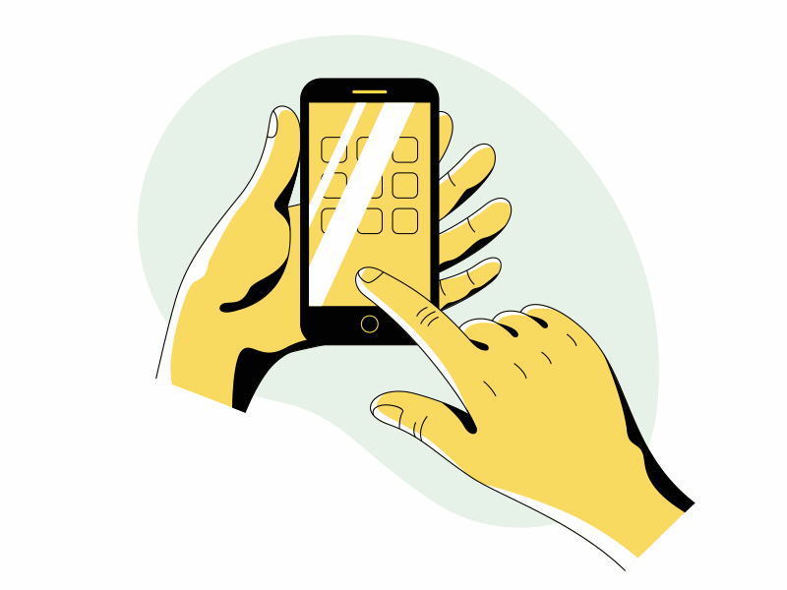


Table of contents
01
02
03
Cyberclubs
Psychological well-being and Digital spaces
Importance in promoting physical health and psychological well being
Impact
Activities and methods of implementation
Physical health and Digital spaces
Impact
Activities and methods of implementation
https://www.dreamstime.com/illustration/pupil-computer-cartoon.html

Slide 3
01
Cyberclubs
Organized groups within schools or educational institutions that focus on enhancing awareness, knowledge, and skills related to various aspects of cybersecurity, digital literacy, and online safety.

Slide 4
Importance?
Physical safety and security awareness
Psychological support and well-being
Social and ethical considerations
Legal awareness and responsibilities
Opportunities in Cyberspace
Threats in Cyberspace
Technical skills development

Slide 5
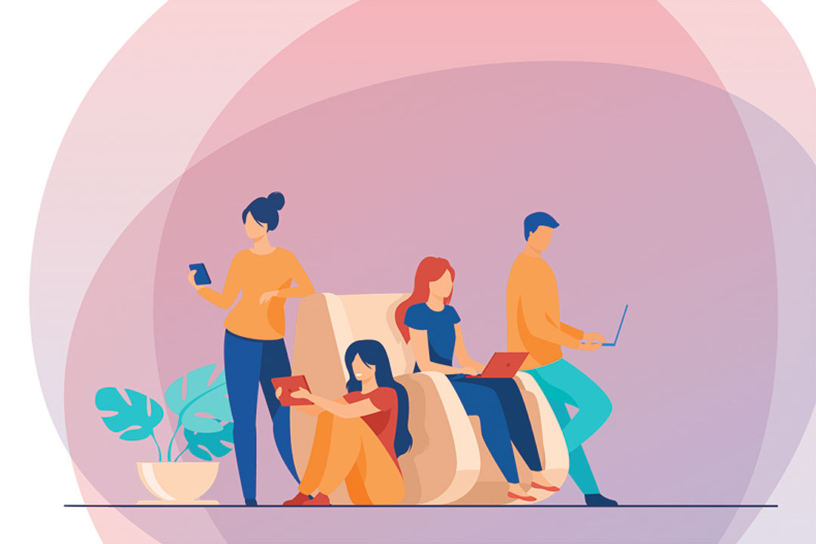
Safe Spaces
https://www.bworldonline.com/opinion/2022/04/19/443078/safe-spaces-in-the-digital-world/

Slide 6
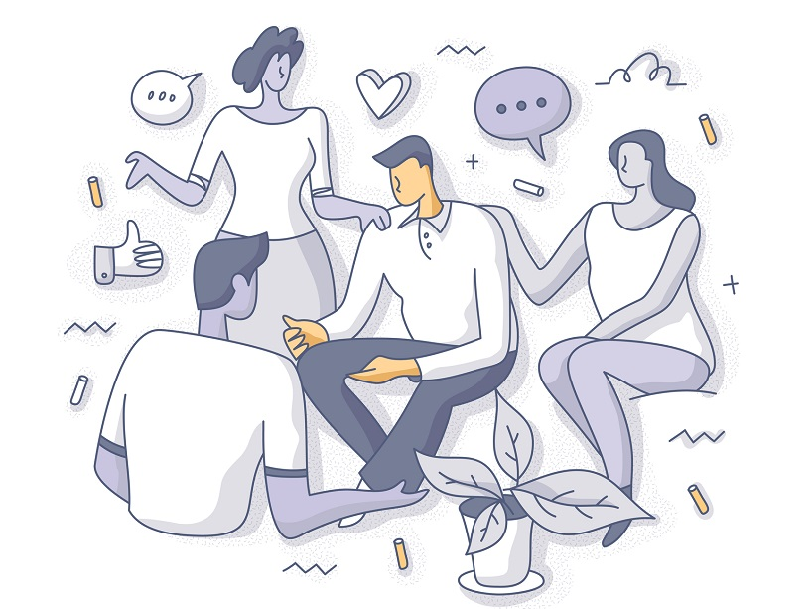
Build Peer Support and Connection!
https://www.torontomu.ca/news-events/news/2021/04/the-power-of-connection/

Slide 7
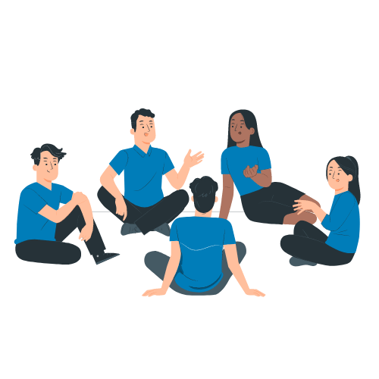
Brainstorm: New Insights!
https://sugarclub.sugarcrm.com/engage/b/sugar-news/posts/meet-other-sugar-customers-and-sme-s-in-the-new-social-club

Slide 8

Creative Collaboration…
https://www.icegif.com/discussion-8/

Slide 9

Feedback
https://elearningindustry.com/7-tips-create-effective-constructive-feedback-system-elearning

Slide 10

Peer Accountability
https://www.linkedin.com/pulse/peer-accountability-critical-success-teams-adam-l-stanley/

Slide 11
Psychological well-being in Digital Spaces
Mental well being
Fear of Missing Out
Difficulty to disconnect
Information Overload
Heightened Stress level
Losing out on real life connections
Constant need for external validation and approval
Comparison- not feeling “Good Enough”
Dissatisfaction, Jealousy and Frustration
Digital Addiction
Cyber-harassment

Slide 12
Psychological well-being in Digital Spaces
Disruption of sleep patterns and chronic fatigue
Increased stress, anxiety, and depression
Inability to concentrate and perform basic tasks.
Decline in academic or work performance
Relationship conflicts and social isolation
Physical symptoms such as headaches, stomachaches

Slide 13
Digital Distress Check!
Cannot stop myself from using my phone
I am sad / stressed / tired
I am angry / irritated
I like to be alone
I can't sleep
I eat less
I can't study for my exam

Slide 14
Digital Distress Check!
Identifying the Situation
Describe the specific situation.
Main triggers/ factors that contributed to your distress.
Emotional Experience
Describe your emotions during the situation
Coping Strategies
What strategies or coping mechanisms did you use?
Preventative Measures
Looking back, what could you have done to prevent it?
Support Systems
How do you think your family, friends, or teachers could have supported you?

Slide 15
Exploring Digital Habits
In the last 24 hours, which digital devices have you used?
List 5 apps/ websites/ games that you have used along with duration.
Were there any moments where you felt you were using digital devices excessively? How did you feel?
Did you take any breaks while using digital devices, and if so, how often?
How do you feel about your overall digital device usage habits?

Slide 16
Exploring Digital Habits
Are there any changes you would like to make?
How do you think your digital device usage impacts your mental health?
Do you feel pressure to constantly check notifications or stay connected online? If so, how do you deal with it?
How has increasing use of digital devices affected your social relationships?
How do you cope with negative experiences encountered while using digital devices?

Slide 17
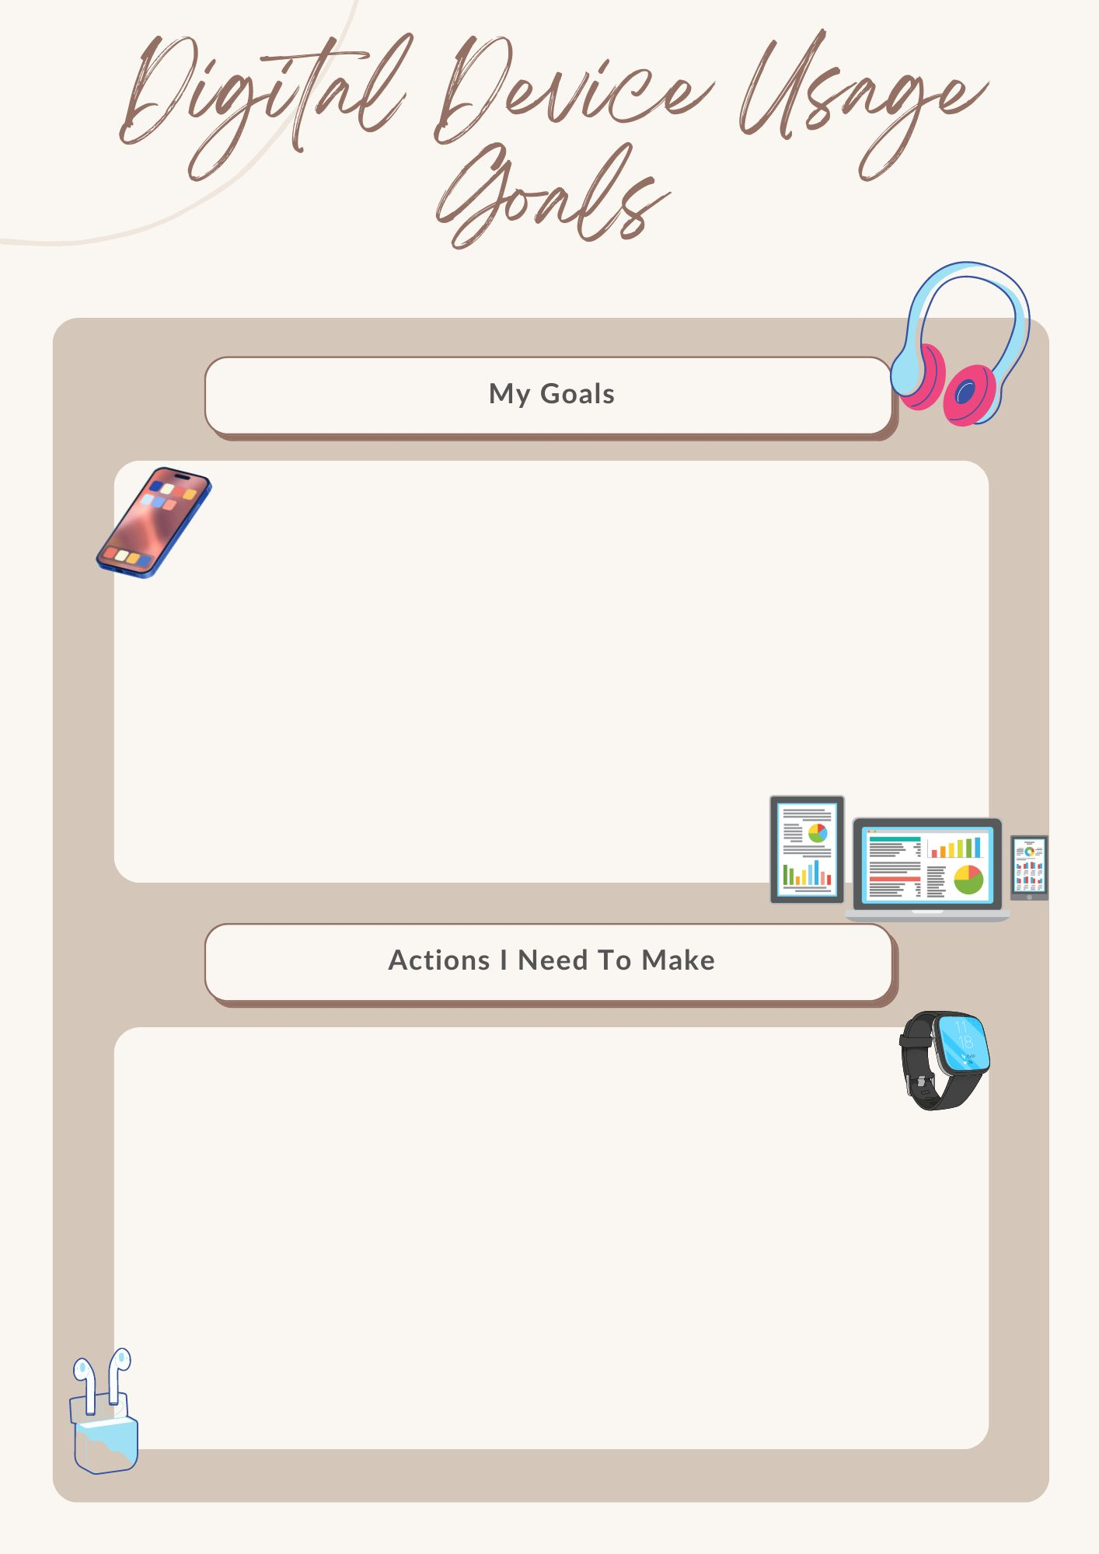

Slide 18
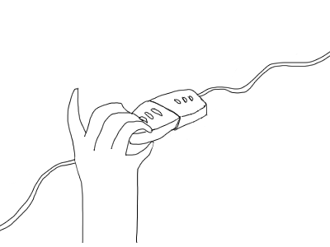
Unplugged: Taking control of my life
Pen and paper activity; in Groups of 2.
Prepare a list of all digital activities performed in the last 24 hours.
Exchange list with partners.
Summarise observations based on:
    Number of common activities
    Number of activities/tasks that could have been done without the use of digital devices
    Number of activities that seemed non-essential and could have been avoided

Slide 19
Unplugged: Taking control of my life
Both partners will engage in discussions and present their findings to the class regarding:
  Activities that can be enjoyed without the use of digital devices.
  Give suggestions for reducing non-essential digital device usage.

Slide 20
Cyber-harassment:
Cyber stalking
Cyber bullying
Track an individual’s location and monitor their activities in the digital space and/or real world.
Creation and sharing of offensive messages, comments or content aimed at shaming, spreading rumors or excluding victims from online groups or activities.
Induce fear and invade privacy

Slide 21
Cyber-harassment
Cyber grooming
Catfishing
Individual builds a friendly relationship, often an emotional connection, with a child over the internet with an intention to exploit the child for sexual purposes.
It includes impersonating someone and sending messages to others or creating fake accounts.
Sensitive information, engage in sexual conversations, or explicit pictures or videos.

Slide 22

Cyber-harassment Roleplay
Enact different ways in which cyber harassment can take place in their school settings.
Brainstorm ways in which peers and teachers should react to ensure mental well-being of the victim.

Slide 23

Tech balance, Mental Health Challenge
Role play/ Skit on any one aspect of mental well being while using digital devices based on their reflections and learnings during the class.

Slide 24
Physical health
Sleep
Lifestyle
Eyes
Ears
Posture

Slide 25

Sleep
Exposure to blue lights
Nature of content
Constant urge to check phone and fear of missing out
Negative experiences online
Late night content consumption
Incorrect postures while using devices in bed

Slide 26
My Sleep Report
At what time did you sleep the previous night?
What was your total duration of sleep?
Did you use your phone just before sleeping?
Did you use your phone as soon as you woke up?
How fresh or energetic do you feel today?

Slide 27
My Sleep Report
Would you like to change your sleep related routine in any way?
How can you create boundaries around device usage to ensure it doesn't interfere with your sleep schedule or academic performance?
Have you explored alternative activities to screen time before going to bed that promote relaxation and better sleep?
What are some changes that you would want to include in your sleep schedule to ensure good sleep?

Slide 28
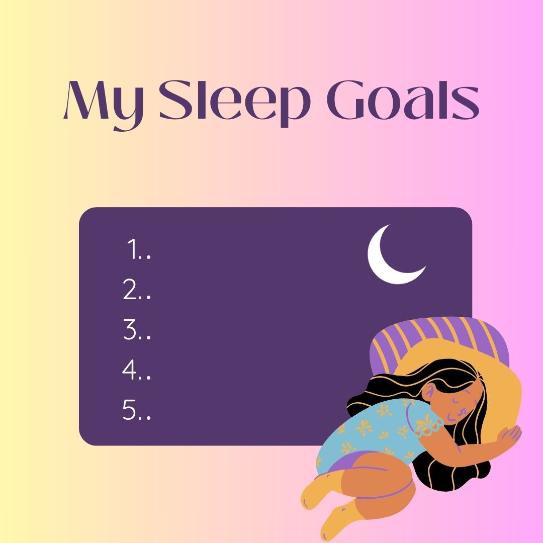

Slide 29


Ears | Eyes
Impaired hearing ability | Eye strain
Persistet ringing or buzzing (tinnitus) | Sensitivity to bright light
Pain and discomfort | Dryness
Ear Infections | Irritation and burning sensation
Compromised ability to hear faint sounds in environment | Tired eyes
 | Blurred vision
 | Headache and fatigue

Slide 30
Safety Challenge
Watching a movie of 3 hours duration on a mobile phone
Playing games on a digital device
Listening to loud music using earphones.
Watching YouTube videos late at night.
Sharing earphones without cleaning them
Using a computer for online classes all day.
Using noise-canceling headphones at maximum volume
Playing mobile games during a long flight.
Binge-watching a TV series on a streaming service
Playing video games with surround sound at high volume
Sleeping with earphones on

Slide 31
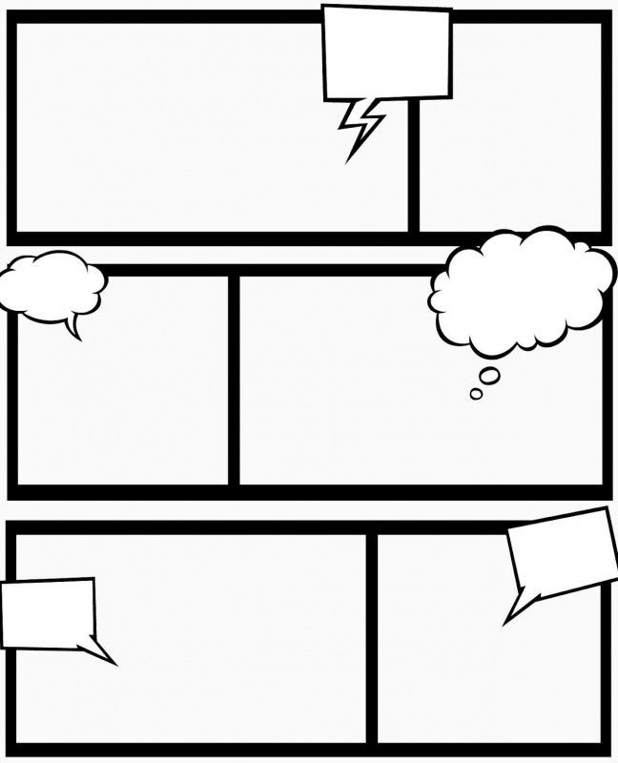
Safety Challenge
Reflect and create a comic strip.
How will this activity affect physical health in the short and long term?
In what ways can they safeguard their physical health while using digital devices in the given situation?

Slide 32
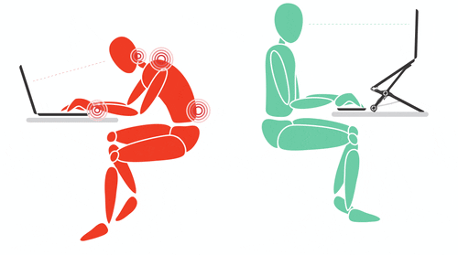
Posture
Incorrect postures over a long period of time.
Repetitive Strain Injury (RSI) or forceful, awkward, and/or repetitive use of limbs.
May cause damage to the muscles, tendons, and nerves
https://leverageedu.com/blog/posture-for-studying/

Slide 33
Hand held devices such as smartphones or laptops require the user to look down and slouch, i.e. keep a low head posture for a long period of time. This may cause headache, neck pain, shoulders and may also affect breathing.
Text Neck

Slide 34
Over-extension of the neck resulting in a posture similar to a turtle. It may lead to increased tension in shoulder and/or neck muscles, headaches, pain and discomfort in the neck, arms, upper back or shoulders.
Turtle neck

Slide 35
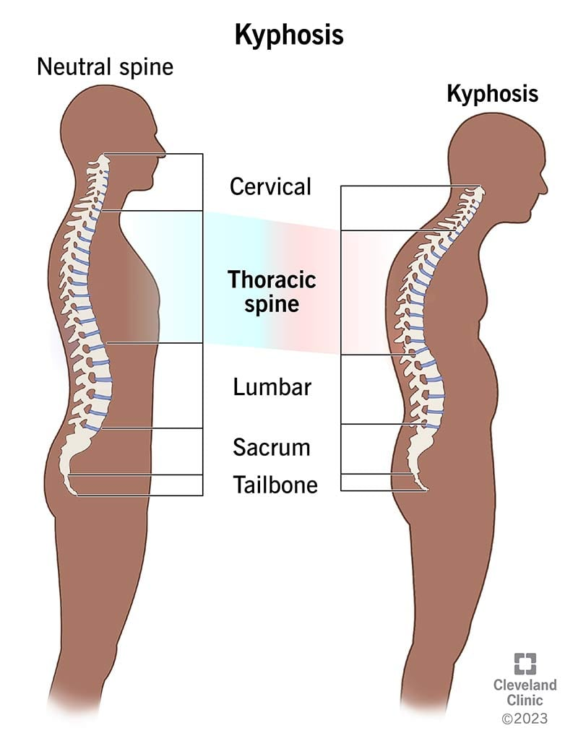
Rounded shoulders/ Kyphosis
Use of digital devices over an extended period of time causes the shoulders to be positioned forward, and rounding of the upper back.
https://my.clevelandclinic.org/health/diseases/17671-kyphosis

Slide 36
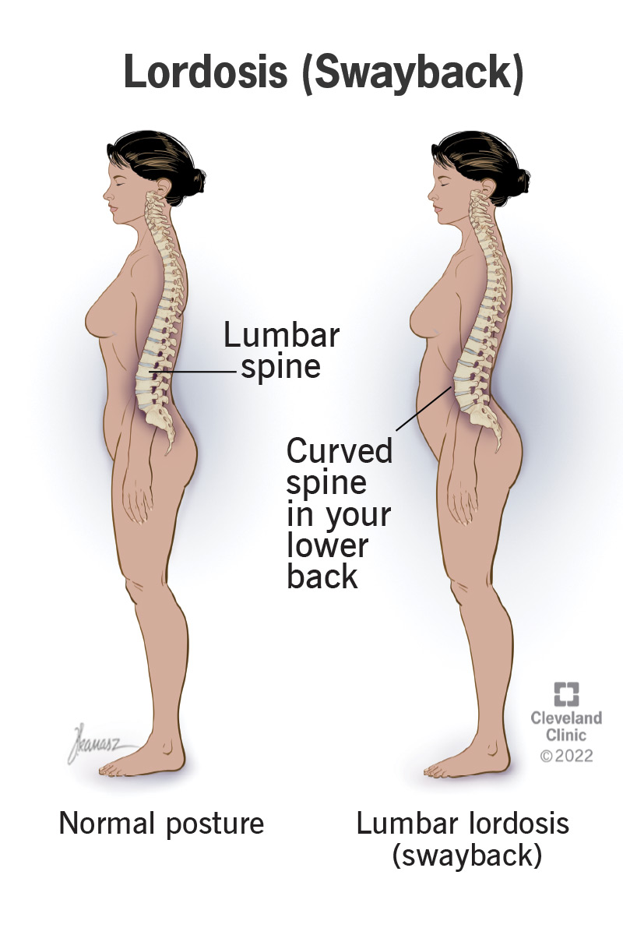
Lordosis
Excessive inward curving of the lower back, often associated with sitting for extended periods with poor lumbar support. It may cause lower back pain and discomfort.
https://my.clevelandclinic.org/health/diseases/23908-lordosis

Slide 37
Cell phone elbow
Bending the elbow for long periods of time when using digital devices can lead to pinching of nerves causing tingling sensations or numbness in the hand. This is also referred to as cubital tunnel syndrome.

Slide 38
Smartphone pinky
Numbness, pain or tingling sensation in the little finger. This could be a symptom of cell phone elbow or result from compression of nerves due to supporting the smartphone with little finger over a long period of time.

Slide 39
Pain, cramping, weakness or numbness in the thumbs and wrist due to repetitive movement while texting or using smartphones.
Texter’s thumb

Slide 40
Posture Police
Form Pairs.
Assign roles related to posture behavior in digital spaces
The Sloucher: A student that demonstrates poor sitting posture while using a digital device.
The Posture Expert: A student that provides guidance on proper posture habits and ergonomic practices.
The Posture Police: The remaining class who will point out errors in the posture of the sloucher.

Slide 41
Posture Police
In each pair, students take turns acting out scenarios related to posture habits and ergonomic practices. The Posture expert will help the Sloucher to improve posture by reading instructions from the Posture Awareness Sheet.

Slide 42
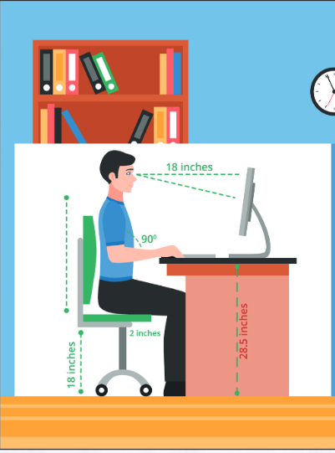
While using desktop computers make sure to:
Sit upright and look straight ahead.
Place the screen right in front of you. You may use a laptop stand or just place some books under the monitor or laptop.
Avoid bending the neck or trunk.
Keep shoulders relaxed and in a neutral position.
Keep the feet flat on the floor and thighs parallel to the floor. Elbow should be close to the sides.
Avoid resting elbows on a hard surface or edge on the table. Wrists should be in a neutral or straight position.
Take brief breaks while working

Slide 43
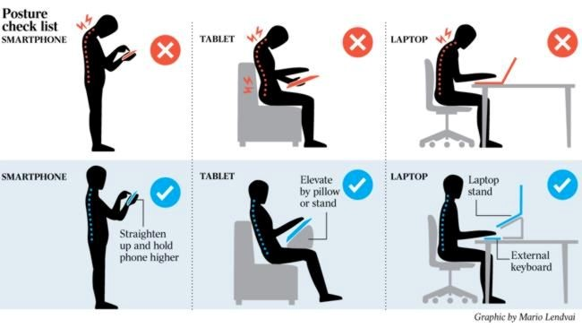
While using handheld devices such as smartphones or tablets.
Sit or stand upright.
Do not slouch or slump.
Alternate fingers when using buttons and/ or touchscreens.
Reduce typing or keystrokes, use speech recognition whenever possible.
Use hands free devices such as earplugs or headphones, to prevent holding devices for extended periods of time.
Hold the devices directly in front of the face when using it.
Avoid excessive looking down when reading texts, emails or other information on the device.
Take frequent breaks from using devices.
https://www.cprtherapy.org/blog/Postural-Awareness-with-Mobile-Devices~6435.html

Slide 44
Posture Police
After the process is complete, the posture expert will declare the sloucher a Posture Pro.
Posture Police will then inspect the posture of the Posture Pro and point out any incorrect postures or device placements.
After all the class groups perform the activity, the team with the best posture and least errors will be declared “Posture Pro”

Slide 45
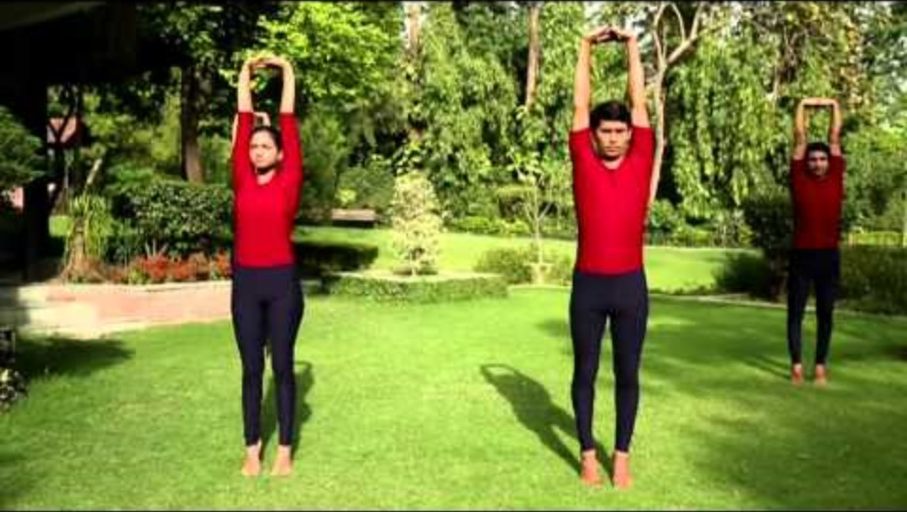
Posture Perfect – Tadasana

Slide 46

Posture Perfect – Vrikshasana

Slide 47

Posture Perfect – Bhujangasana

Slide 48
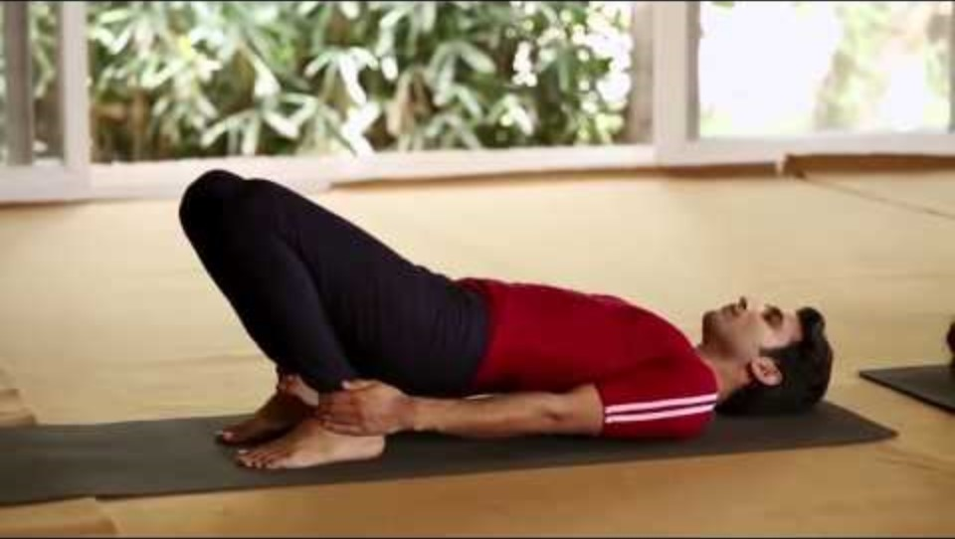
Posture Perfect – Setu Bandhasana

Slide 49

Digital Device, Health Precise!
Write a verse/ rhyme on good physical health in digital space.
https://www.wattpad.com/500570021-breathe-me-write-a-poem

Slide 50
Important takeaways!
Respect each other
Protect privacy of fellow mates
Follow through!

Slide 51
Thank You!

